Slide 1
Expert Systems
Dr. Ahmed Ayman

Slide 2
Definition
Expert Systems are computer programs that exhibit intelligent behavior. They are concerned with the concepts and methods of symbolic inference, or reasoning, by a computer, and how the knowledge used to make those inferences will be represented.

Slide 3
Types of Expert Systems
• Rule-Based Systems – Use if-then rules.
• Fuzzy Logic Systems – Handle uncertainty with degrees of truth.
• Neural Network-Based Systems – Learn from data.
• Hybrid Systems – Combine multiple AI techniques.

Slide 4
Applications of Expert Systems
Medical diagnosis:
Expert systems can be used to help diagnose diseases and recommend treatments.
Financial analysis:
Expert systems can be used to analyze financial data and make investment decisions.
Engineering design:
Expert systems can be used to design and optimize products.
Customer service: Expert systems can be used to provide customer support.
Military Planning – AI-assisted mission strategy.
Industrial Automation – Predictive maintenance.
Legal Decision Support – Case law analysis.

Slide 5
Expert Systems – Components of Expert Systems
knowledge base
contains essential information about the problem domain
often represented as facts and rules
inference engine
mechanism to derive new knowledge from the knowledge base and the information provided by the user
often based on the use of rules
user interface
interaction with end users
development and maintenance of the knowledge base

Slide 6
Concepts & Characteristics of Expert Systems
knowledge acquisition
transfer of knowledge from humans to computers
sometimes knowledge can be acquired directly from the environment
machine learning, neural networks
knowledge representation
suitable for storing and processing knowledge in computers
inference
mechanism that allows the generation of new conclusions from existing knowledge in a computer
explanation
illustrates to the user how and why a particular solution was generated

Slide 7
Expert Systems – Building Blocks of Expert Systems
Knowledge Base
Expertise
User Interface
Facts / Observations
Knowledge / Rules
Inference Engine
Expertise
Developer

Slide 8
Expert Systems – Rules and Humans
Rules can be used to formulate a theory of human information processing (Newell & Simon)
rules are stored in long-term memory
temporary knowledge is kept in short-term memory
(external) sensory input triggers the activation of rules
activated rules may trigger further activation (internal input; “thinking”)
a cognitive processor combines evidence from currently active rules
this model is the basis for the design of many rule-based systems.

Slide 9
Early Expert Systems Success Stories
DENDRAL (Feigenbaum, Lederberg, and Buchanan, 1965)
deduce the likely molecular structure of organic chemical compounds from known chemical analyses and mass spectrometry data
MYCIN (Buchanan and Shortliffe, 1972-1980)
diagnosis of infectious blood diseases and recommendation for use of antibiotics
PROSPECTOR
analysis of geological data for minerals
discovered a mineral deposit worth $100 million
XCON/R1 (McDermott, 1978)
configuration of DEC VAX computer systems
2500 rules; processed 80,000 orders by 1986; saved DEC $25M a year

Slide 10
Expert Systems – Keys to Expert Systems Success
convincing ideas
rules, cognitive models
practical applications
medicine, computer technology, …
separation of knowledge and inference
expert system shell
allows the re-use of the “machinery” for different domains
concentration on domain knowledge
general reasoning is too complicated

Slide 11
When not to use an Expert System
Expert systems are not suitable for all types of domains and tasks
They are not useful or preferable, when …
efficient conventional algorithms are known
the main challenge is computation, not knowledge
knowledge cannot be captured efficiently or used effectively
users are reluctant to apply an expert system, e.g. due to criticality of task, high risk or high security demands

Slide 12
Expert Systems Elements
Knowledge base
Inference engine
Working memory
Agenda
Explanation facility
Knowledge acquisition facility
User interface

Slide 13
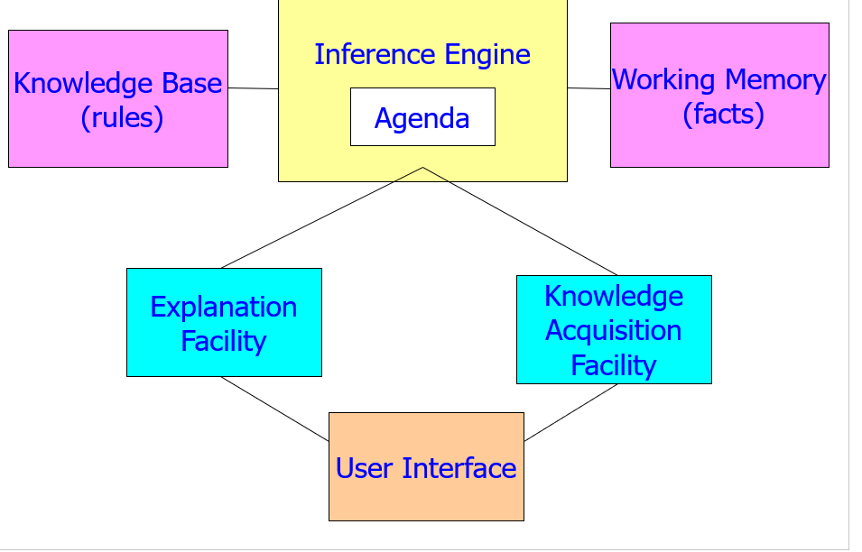

Slide 14
Rule-Based Expert Systems
knowledge is encoded as IF … THEN rules
Condition-action pairs
the inference engine determines which rule (condition-part) are satisfied.
matching rules are “activated”, i.e. placed on the agenda
Rules on the agenda can be executed (“fired”).

Slide 15
Example Rules
IF … THEN Rules
Rule: Red_Light
IF the light is red (antecedent)
THEN stop (consequent)
Rule: Green_Light
IF the light is green
THEN go
Production Rules
the light is red ==> stop (left-hand side - antecedent)
(right-hand side - consequent)
the light is green ==> go

Slide 16
Inference Engine Cycle
describes the execution of rules by the inference engine “recognize-act cycle”
pattern matching
update the agenda (= conflict set)
add rules, whose antecedents are satisfied
remove rules with non-satisfied antecedents
conflict resolution
select the rule with the highest priority from the agenda
execution
perform the actions in the consequent part of the selected rule
remove the rule from the agenda
the cycle ends when no more rules are on the agenda, or when an explicit stop command is encountered

Slide 17
Forward and Backward Chaining
different methods of reasoning and rule activation
forward chaining (data-driven)
reasoning from facts to the conclusion
as soon as facts are available, they are used to match antecedents of rules
a rule can be activated if all parts of the antecedent are satisfied
often used for real-time expert systems in monitoring and control
examples: CLIPS, OPS5
backward chaining (query-driven)
starting from a hypothesis (query), supporting rules and facts are sought until all parts of the antecedent of the hypothesis are satisfied
often used in diagnostic and consultation systems
examples: EMYCIN

